Slide 1
Neural Word Embeddings S. Sathiya Keerthi** Cloud & Information Services Lab Microsoft Mountain View, CA, USA
* Links to pdfs of all mentioned references are in the appendix
**Joint work with Tobias Schnabel (Cornell University) & Rajiv Khanna (UT Austin)

Slide 2
The problem
Model similarity between textual objects – words, sentences, documents
This talk will focus on words
In NLP/CL literature this work has been discussed under the topic called Distributional Similarity Models (DSMs)
Recently there has been exciting research in Neural models
The aim of this talk is to give an overview of these models

Slide 3
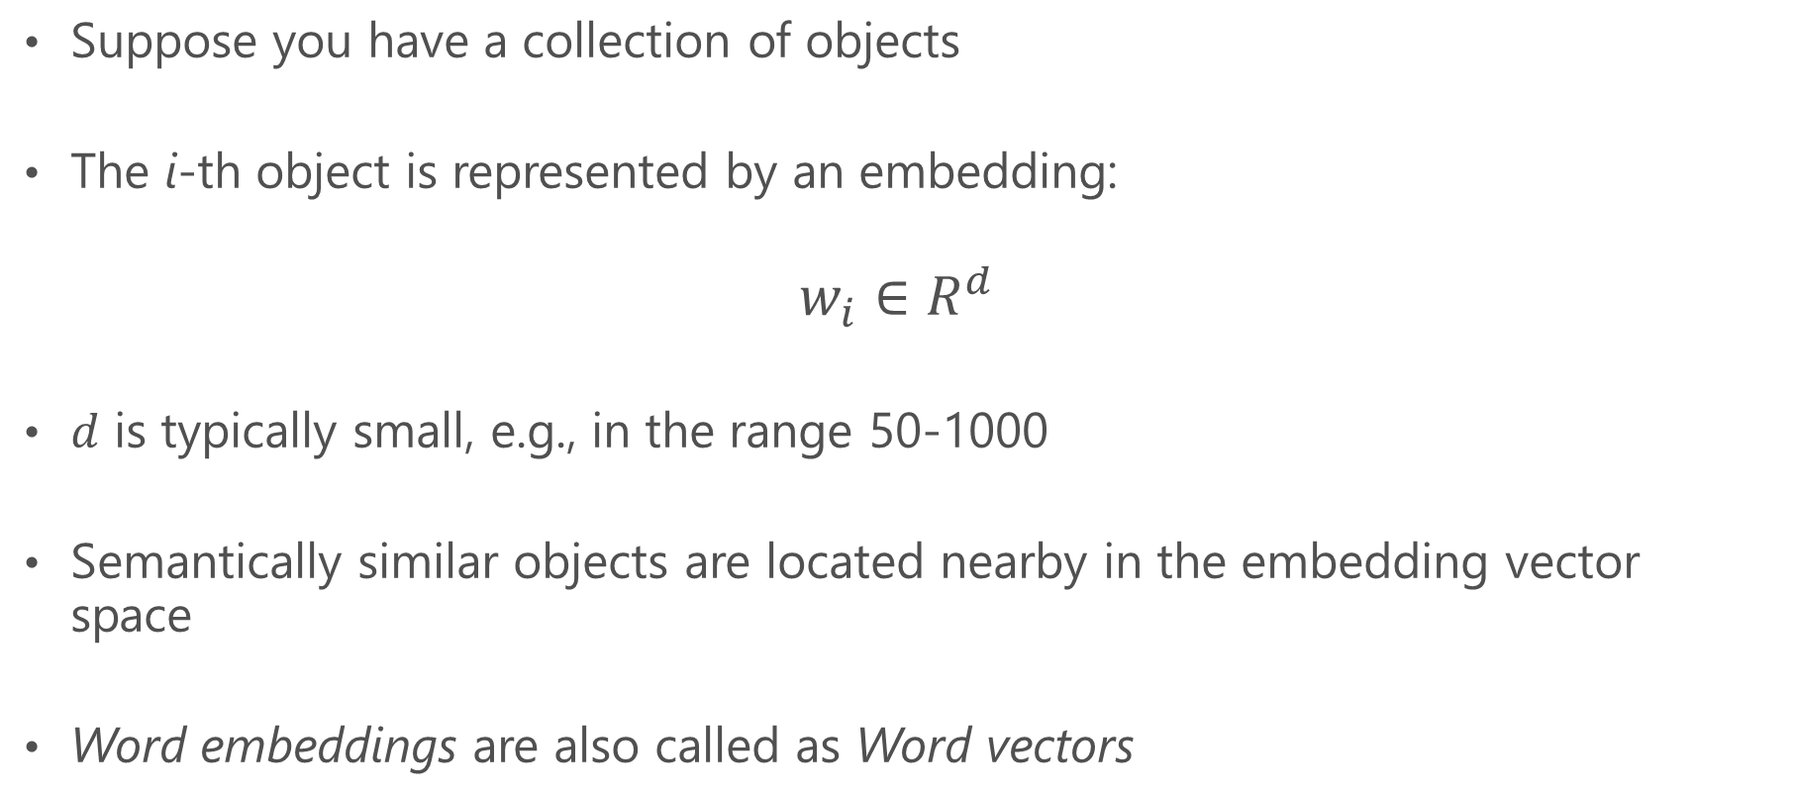
What is an embedding?
Suppose you have a collection of objects
The i-th object is represented by an embedding:
$$w_{i}∈R^{d}$$
$d$ is typically small, e.g., in the range 50-1000
Semantically similar objects are located nearby in the embedding vector space
Word embeddings are also called as Word vectors

Slide 4
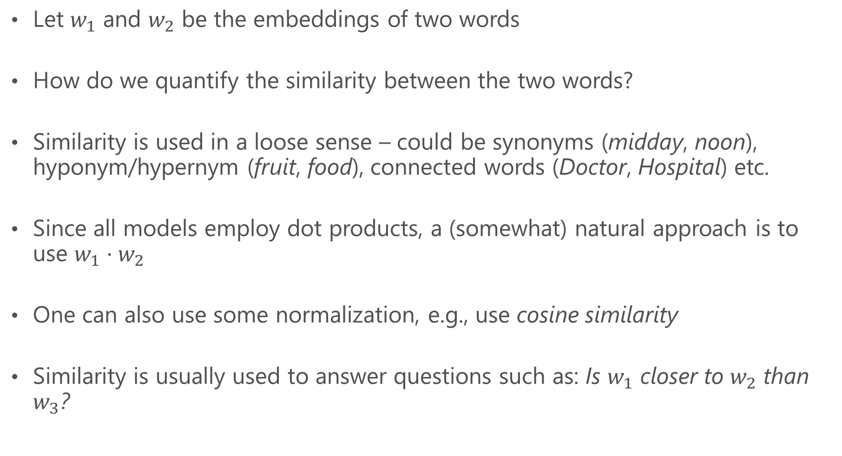
Compute similarity using embeddings
Let $w_{1}$ and $w_{2}$ be the embeddings of two words
How do we quantify the similarity between the two words?
Similarity is used in a loose sense – could be synonyms (midday, noon), hyponym/hypernym (fruit, food), connected words (Doctor, Hospital) etc.
Since all models employ dot products, a (somewhat) natural approach is to use $w_{1}⋅w_{2}$
One can also use some normalization, e.g., use cosine similarity
Similarity is usually used to answer questions such as: Is $w_{1}$ closer to $w_{2}$ than $w_{3}$?

Slide 5
What are some uses of word embeddings?*
Computing word similarity, doing better word clustering
Word classification, e.g., positive versus negative words
Automatic thesaurus generation – need to use particular kind of similarity that is appropriate for a thesaurus
Context sensitive spelling correction
Can be used as features in NLP systems avoiding the need for hand crafted features specific to each NLP problem
Query expansion – based on words closer to query words in the embedding space. Also applicable to advertising bid terms expansion
* See sec 6.2 of Turney and Pantel (2010)

Slide 6
A tf-idf based approach*
Representing documents as a vector/bag of words using tf (term frequency) and idf (inverse document frequency) is well known
To represent a word, you can just invert the idea – represent a word by the documents it is contained in. You can also use concepts dual to tf and idf
This – and shortened reps via SVD or other means - give a vectorial representation of each word, which can be considered as word embeddings
But the approach is only useful at a gross level
* Landauer et al (1998)

Slide 7
Many problems require finer semantics*
Authorship attribution
Author profiling
Gender identification
Native language identification
Sentiment analysis
Detection of illegal behaviors on the web
Plagiarism detection
* Most folks think doc reps via tf-idf is good for all text classification – but that is not true

Slide 8
How do we build semantic embeddings?
Labeled datasets are impossible for such a large task
Plenty of unlabeled textual data is available
But what is the signal in such data?
"How much do we know at any time?
Much more, or so I believe, than we know we know."
-Agatha Christie, The Moving Finger

Slide 9
The distributional hypothesis
Quotes:
Meaning is use .. Wittgenstein, 1953
You shall know a word by the company it keeps .. Firth, 1957
If two words share similar contexts, we can assume that they have similar meanings
Comparing meanings reduces to comparing contexts
Takeaway – Represent each word as a vector of context features

Slide 10
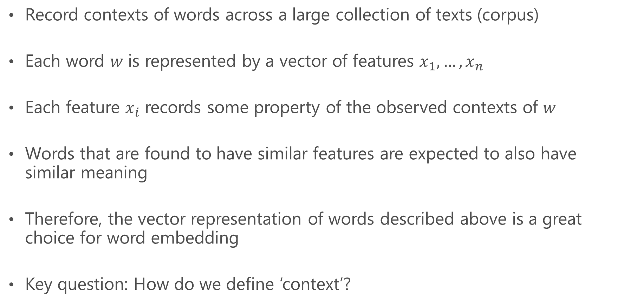
The distributional approach
Record contexts of words across a large collection of texts (corpus)
Each word $w$ is represented by a vector of features $x_{1},…, x_{n}$
Each feature $x_{i}$ records some property of the observed contexts of $w$
Words that are found to have similar features are expected to also have similar meaning
Therefore, the vector representation of words described above is a great choice for word embedding
Key question: How do we define ‘context’?

Slide 11
Pre-processing

Slide 12
Forming words
Raw: The programmer’s programs had been programmed.
Tokenized: the programmer ’s programs had been programmed
Lemmatized: the programmer ’s program have be program
W/ stop-list: programmer program program
Stemmed: program program program

Slide 13
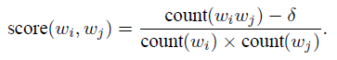
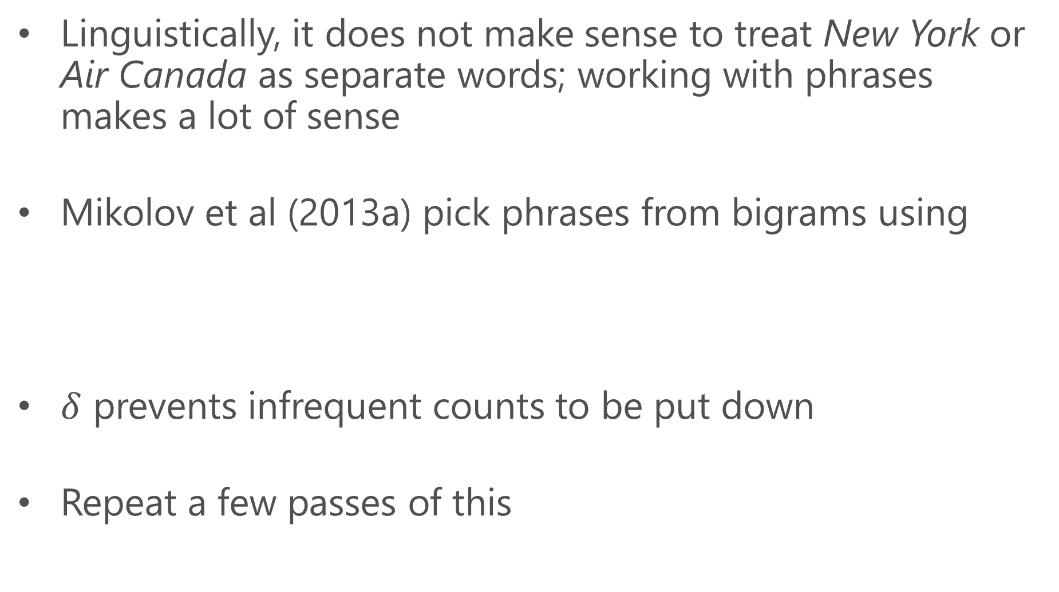
Forming word phrases
Linguistically, it does not make sense to treat New York or Air Canada as separate words; working with phrases makes a lot of sense
Mikolov et al (2013a) pick phrases from bigrams using
$δ$ prevents infrequent counts to be put down
Repeat a few passes of this

Slide 14
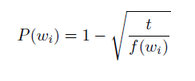
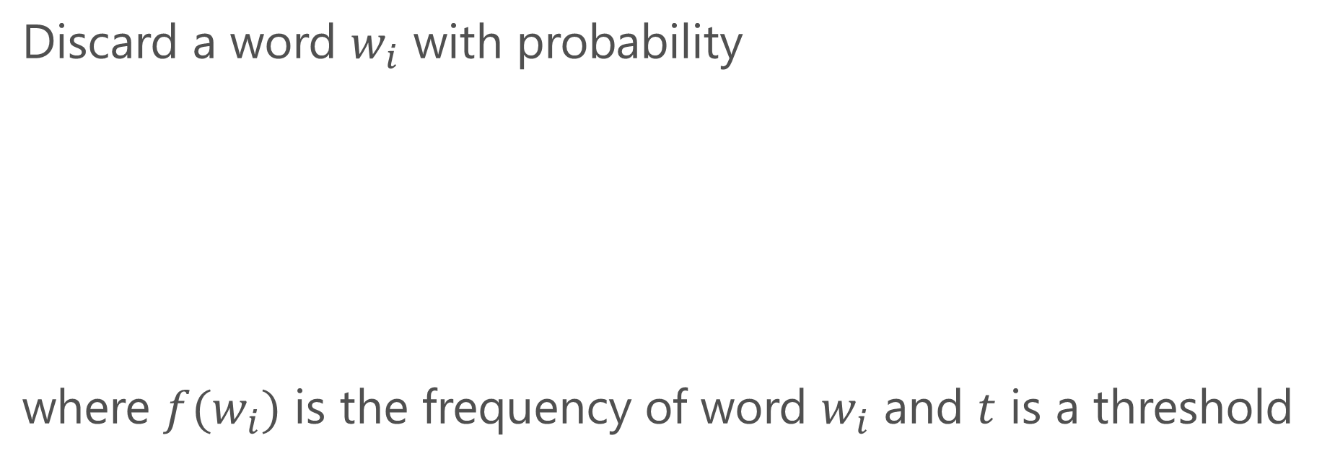
Down-sampling frequent words
Discard a word $w_{i}$ with probability
where $f(w_{i})$ is the frequency of word $w_{i}$ and $t$ is a threshold

Slide 15
Distributional Semantic Models (aka Count Models)

Slide 16
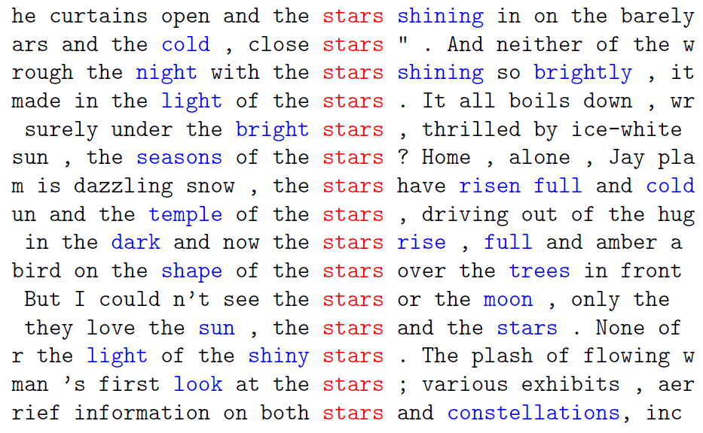
* Thanks – Grefenstette et al (2014)

Slide 17
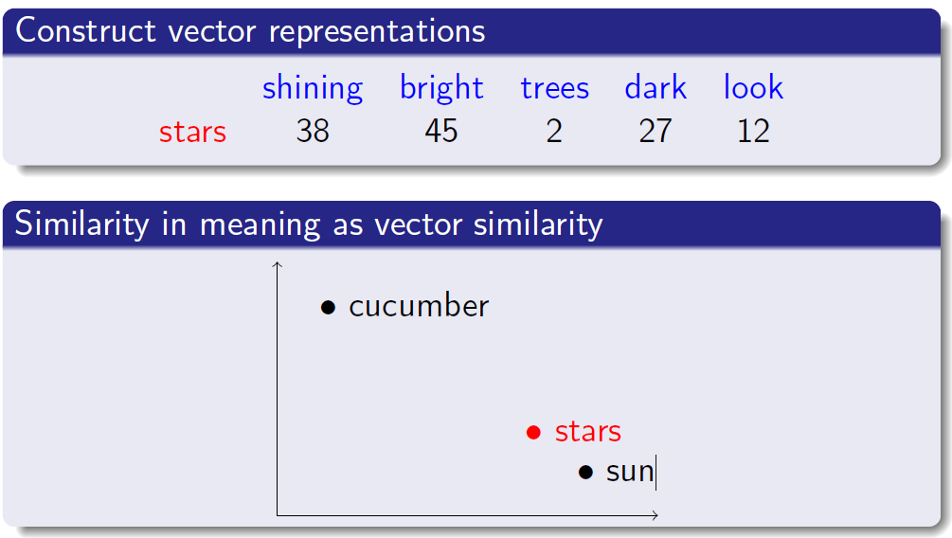

Slide 18
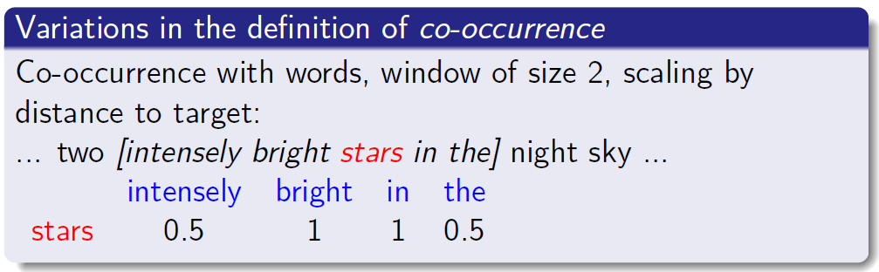

Slide 19
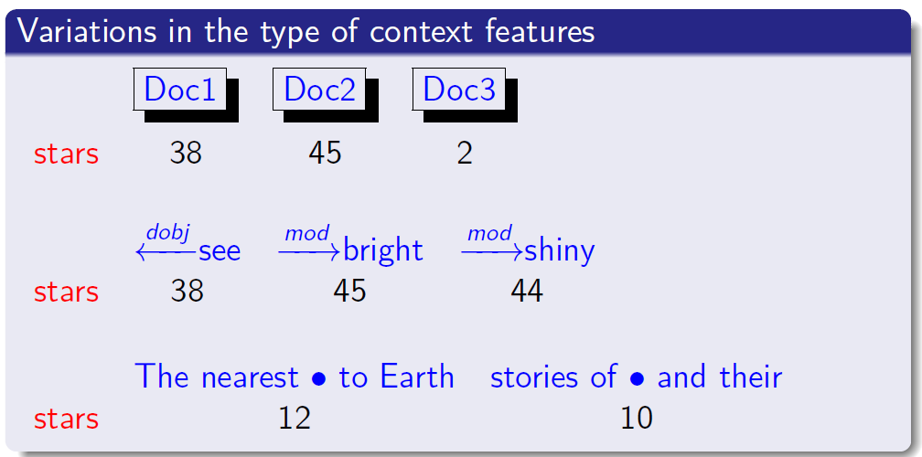
Context = the Grammatical relations of the word to other words in the sentence

Slide 20
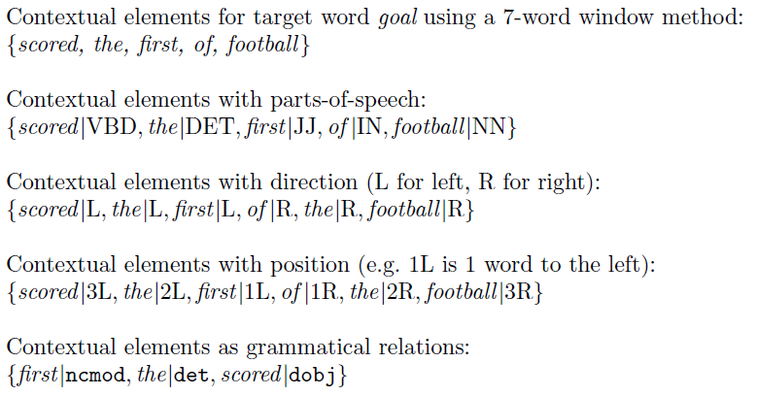
Example describing contexts*
* Clark (2015)

Slide 21
Weighting of context elements
Give more weight to surprising (rare) contexts and less weight to expected (frequent) contexts
Example: For the word rat, the contexts dissect and exterminate are more discriminative than words such as have and like
One could use tf-idf ideas here
A range of different tests of statistics are used; e.g. pointwise mutual Information (PMI), log odds ratio, t-test, log likelihood
PMI and PPMI (Positive PMI) have shown up well in evaluations – see Bullinaria et al, 2011, 2012 for extensive computational experiments

Slide 22
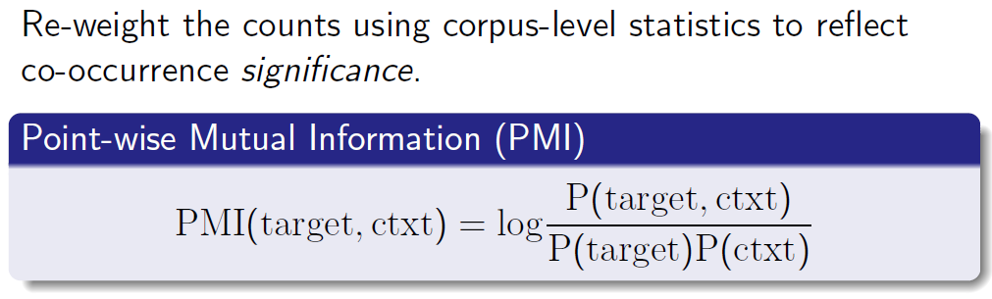

Slide 23
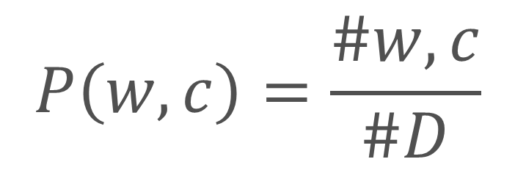


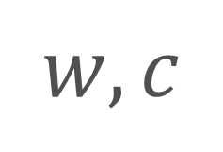
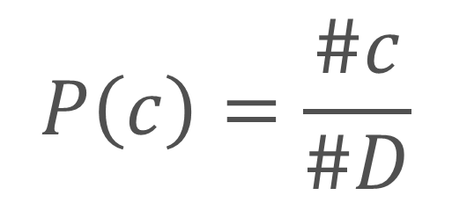
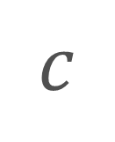
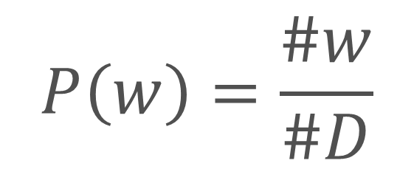
$$P\left(w,c\right)=\frac{\#w,c}{\#D}$$
$$P\left(w\right)=\frac{\#w}{\#D}$$
$$w,c$$
$$w$$
$$c$$
$$P\left(c\right)=\frac{\#c}{\#D}$$
$$D$$
$$PMI=\log{P(w,c)}−\log{P\left(w\right)}−\log{P(c)}$$

Slide 24
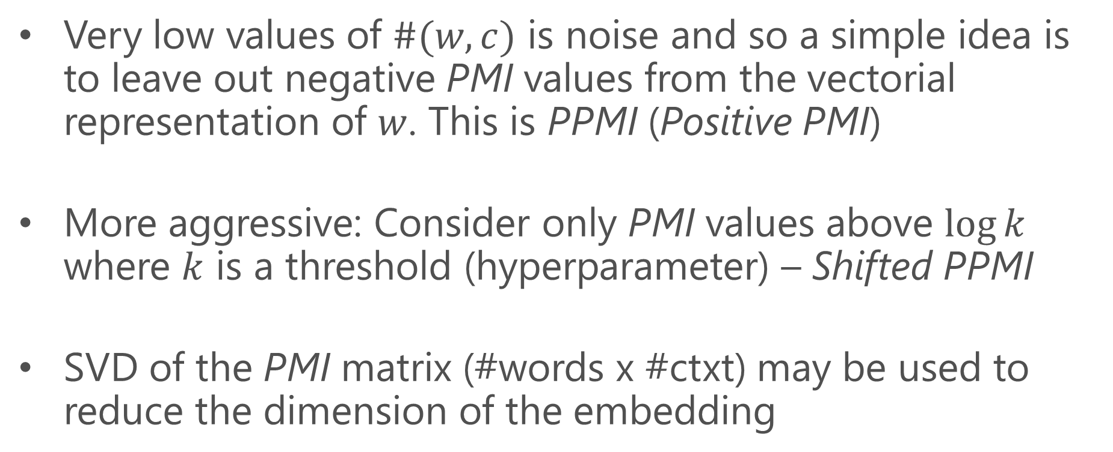
More on PMI…
Very low values of $\#(w,c)$ is noise and so a simple idea is to leave out negative PMI values from the vectorial representation of $w$. This is PPMI (Positive PMI)
More aggressive: Consider only PMI values above $\log{k}$ where $k$ is a threshold (hyperparameter) – Shifted PPMI
SVD of the PMI matrix (#words x #ctxt) may be used to reduce the dimension of the embedding

Slide 25
Neural Models (aka Predict Models)

Slide 26
History
Origins in the work of Bengio et al (2003) – Probabilistic Language models
Mnih & Hinton (2007) proposed the Log bilinear scoring model
Mikolov & colleagues simplified the model in various ways for forming word embeddings

Slide 27
CBOW
$P\left(Cat\right)=exp⁡(s\left(Cat\right))/Z$ where $Z=\sum_{w}{exp⁡(s\left(w\right))}$
Each word $w$ in vocabulary gets a score $s(w)$
Soft-max
Neural Network
(with parameters)
Embeddings of
Context words
Rat and Bat are dancing but Cat won't get up off the mat.
Left context
Word
Right context
Context embeddings and neural net parameters are all unknowns that are tuned
But where are the word embeddings??

Slide 28
Training process
Apply the model described treating every word occurrence in the data as a training example
Since no manual labeling is involved, it is easy to collect billions of examples
Minimize the total Negative Log Likelihood formed with the soft-max probabilities
Stochastic gradient descent is usually used
After training, there is no role for context embeddings – scope for research

Slide 29
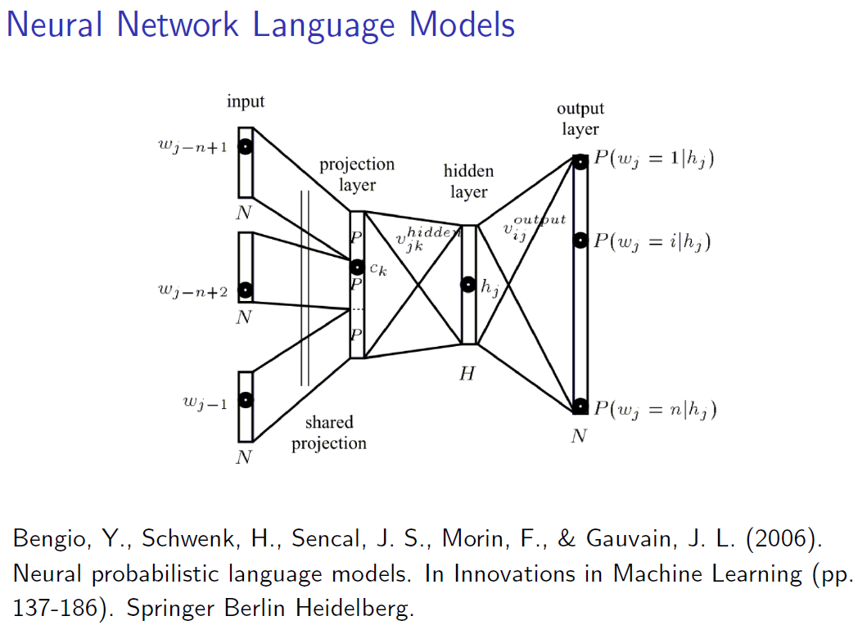
Word embeddings

Slide 30
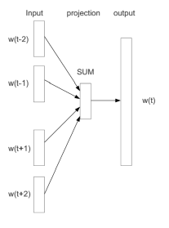
CBOW
CBOW = Continuous bag-of-words model
Sums the embeddings of context words
After that it is just a linear net to form word scores
The parameters of the linear net give the word embeddings
Linear net
* Mikolov et al (2013a,b)

Slide 31
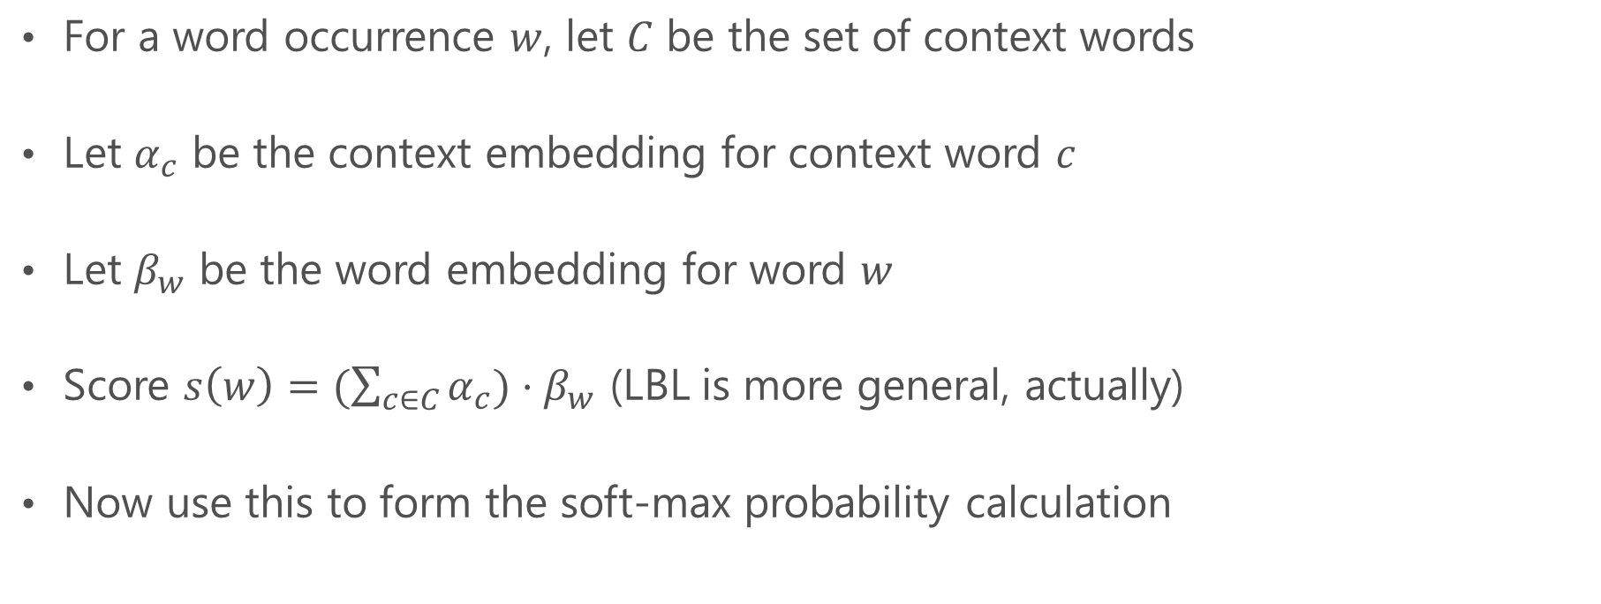
Log bilinear (LBL) model*
For a word occurrence $w$, let $C$ be the set of context words
Let $α_{c}$ be the context embedding for context word $c$
Let $β_{w}$ be the word embedding for word $w$
Score $s\left(w\right)=(\sum_{c∈C}{α_{c}})⋅β_{w}$ (LBL is more general, actually)
Now use this to form the soft-max probability calculation
* Mnih and Hinton (2007)

Slide 32
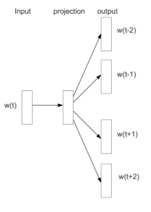
Skip-gram model
Reverse CBOW – Use the word to predict the context words
Complication: Output is a sequence
To simplify, the context words prediction is treated as a separate (but identical) set of soft-maxes
Word embedding
* Mikolov et al (2013a,b)

Slide 33
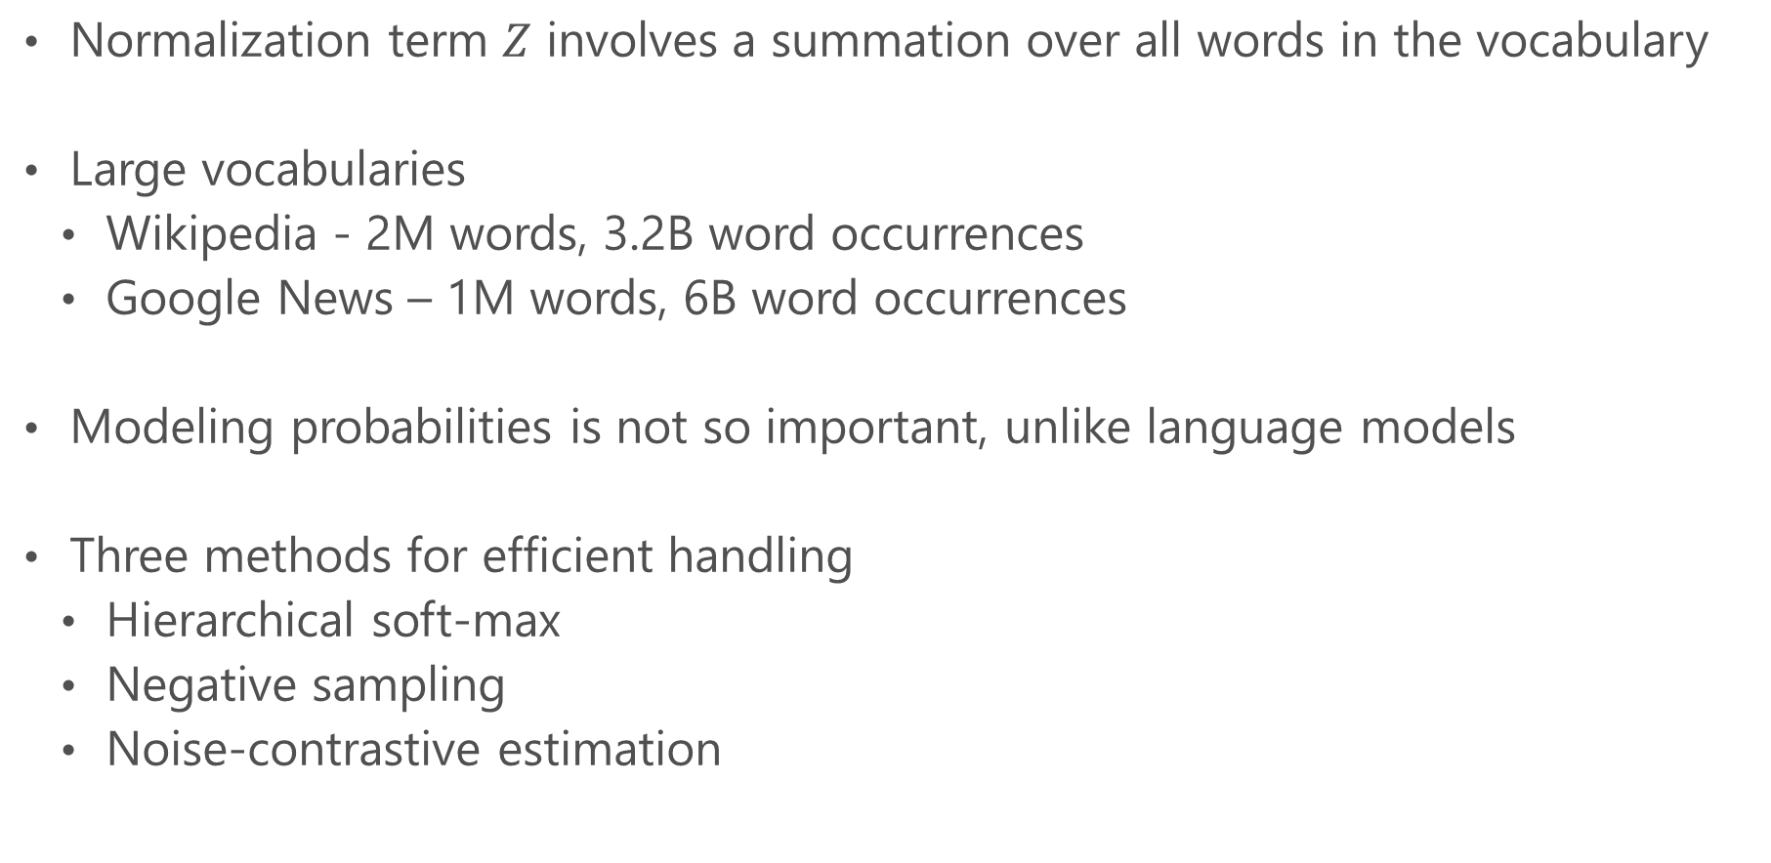
Computational bottleneck of soft-max
Normalization term $Z$ involves a summation over all words in the vocabulary
Large vocabularies
Wikipedia - 2M words, 3.2B word occurrences
Google News – 1M words, 6B word occurrences
Modeling probabilities is not so important, unlike language models
Three methods for efficient handling
Hierarchical soft-max
Negative sampling
Noise-contrastive estimation

Slide 34
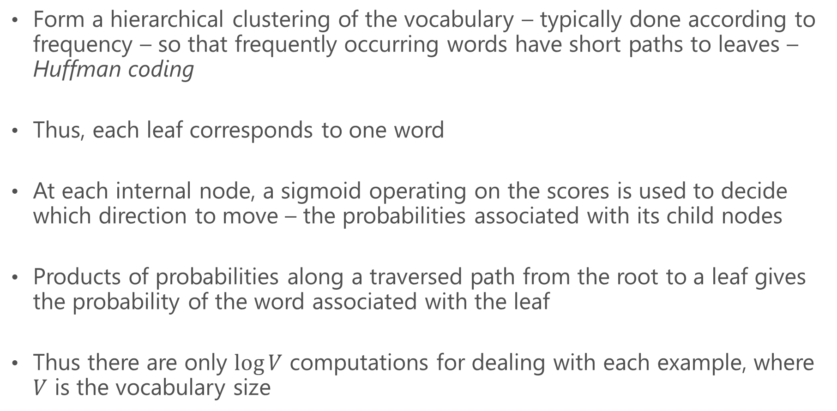
Hierarchical soft-max*
Form a hierarchical clustering of the vocabulary – typically done according to frequency – so that frequently occurring words have short paths to leaves – Huffman coding
Thus, each leaf corresponds to one word
At each internal node, a sigmoid operating on the scores is used to decide which direction to move – the probabilities associated with its child nodes
Products of probabilities along a traversed path from the root to a leaf gives the probability of the word associated with the leaf
Thus there are only $\log{V}$ computations for dealing with each example, where $V$ is the vocabulary size
* Morin and Bengio (2005); Mikolov et al (2013a,b)

Slide 35
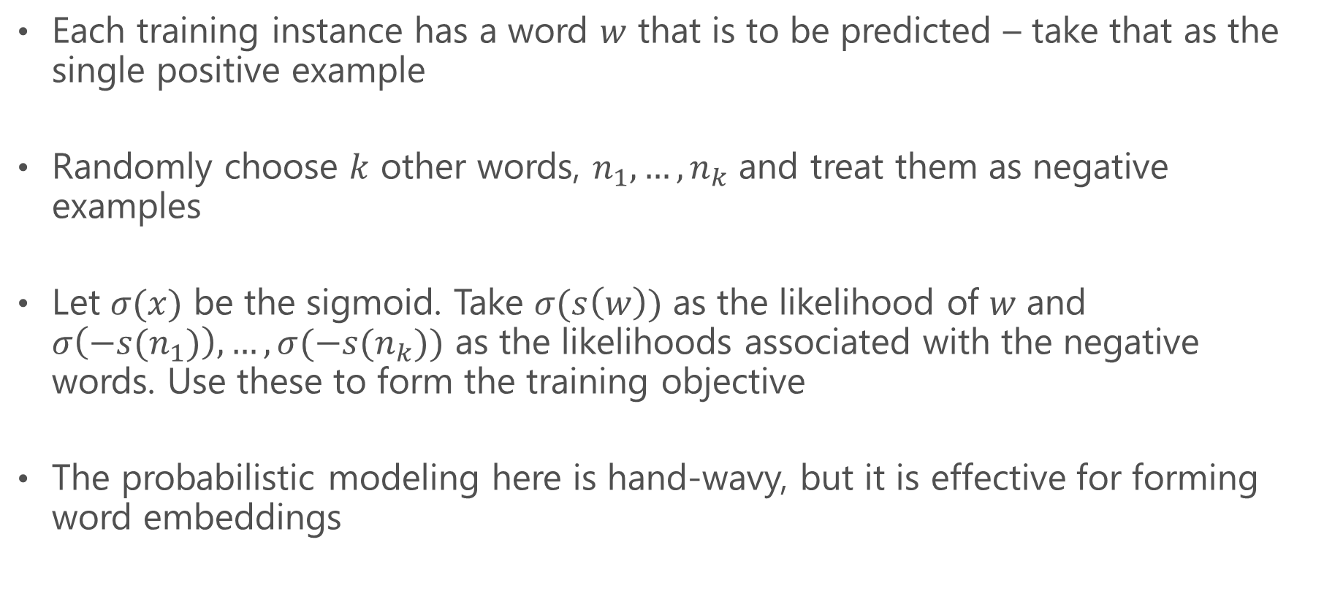
Negative sampling
Each training instance has a word $w$ that is to be predicted – take that as the single positive example
Randomly choose $k$ other words, $n_{1},…, n_{k}$ and treat them as negative examples
Let $σ(x)$ be the sigmoid. Take $σ(s\left(w\right))$ as the likelihood of $w$ and $σ\left({−s(n}_{1})\right), …, σ({−s(n}_{k}))$ as the likelihoods associated with the negative words. Use these to form the training objective
The probabilistic modeling here is hand-wavy, but it is effective for forming word embeddings
* Mikolov et al (2013a)

Slide 36
Noise-contrastive estimation
Choose a noise distribution (usually some kind of a mean distribution over all words)
Choose negative examples according to the noise distribution
Unlike Negative sampling, this method enjoys some nice asymptotic properties
* Mnih and Kavukcuoglu (2013)

Slide 37
Speedup
Hierarchical soft-max is an order of magnitude faster than soft-max
Training time reduced from days to a few hours
Negative sampling and Noise-contrastive estimation are also very fast

Slide 38
Word2vec
Codes:
Google - http://code.google.com/p/word2vec/
Gensim - http://radimrehurek.com/gensim/models/word2vec.html
Tools for training word vectors using CBOW and Skip-Gram models – both negative sampling and hierarchical softmax are supported
Optimized for very large datasets - >billions of training (word, context) pairs
Pre-trained word vectors are also available to play with

Slide 39
Linguistic Regularities

Slide 40
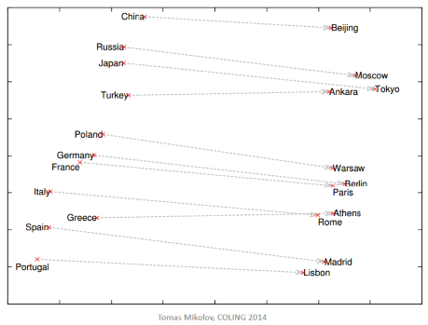
Country and Capital vectors projected by PCA
Word vectors from neural models exhibit linear structure that enables checking analogies with vector arithmetic
Given two examples of a relationship, e.g.,
Beijing is to China as Moscow is to Russia
The closest point to vec[Beijing] + (vec[Russia] – vec[Moscow]) will be vec[China]
* Mikolov, Yih and Zweig (2013); Mikolov et al (2013a,b)

Slide 41
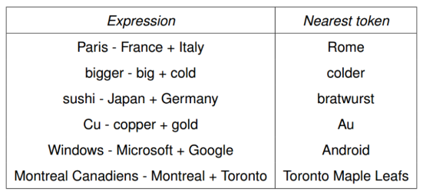
More examples
Non-linear networks satisfy such linear linguistic regularities poorly!

Slide 42
Evaluation

Slide 43
Dataset 1
MSR dataset with 8K questions, mostly focuses on syntax - examples
good:better rough: ________
good:best rough: ________
better:best rougher: ________
year:years law: ________
see:saw return: ________

Slide 44
Dataset 2
Google word-based dataset, almost 20K questions, focuses on both syntax and semantics
Athens:Greece Oslo: ________
Angola:kwanza Iran: ________
brother:sister grandson: ________
possibly:impossibly ethical: ________
walking:walked swimming: ________

Slide 45
Dataset 3
Google phrase-based dataset, focuses on semantics
New York:New York Times Baltimore: ________
Boston:Boston Bruins Montreal: ________
Detroit:Detroit Pistons Toronto: ________
Austria:Austrian Airlines Spain: ________
Steve Ballmer:Microsoft Larry Page: ________

Slide 46
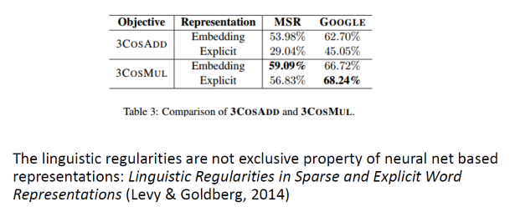
Some performance numbers
These are two
different ways of
checking analogies
Count model
Predict model
* Levy and Goldberg (2014)

Slide 47
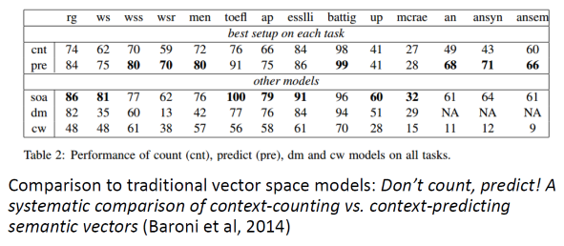
Better to Predict than Count
* Baroni et al (2014) – The datasets of row 1 are expanded in the appendix

Slide 48
Extensions

Slide 49
Connecting Count and Predict Models
Levy and Goldberg (2014c) have established the following
SGNS (Skip-gram with negative sampling) is a count based model
An extreme case of it gives Shifted PPMI
We have done a more detailed analysis – indicates that overfitting could be the reason for the inferior performance of PMI methods
Regularization can help with this – study underway
The low dimensionality of the embedding space used by SGNS gives an automatic regularization due to reduced number of embedding parameters

Slide 50
Supervised models
For a given supervised learning problem, it is appropriate to
Use the extra labeled data to guide the embedding vectors
Make the right choice of context and other hyper-parameters

Slide 51
Multiple word prototypes
Polysemy. Take the word Plant. Using only one representation results in Plant getting an embedding that is the average of its different semantic versions relating to biology, placement, manufacturing and power generation.
Need ways of identifying polysemous words and allow such words to have multiple word vectors
* Neelakantan et al (2014)

Slide 52
Compositional models
Creation of vectors/embeddings for phrases, sentences and documents
Man killed dog to be much closer to Man murdered cat than Man was killed by dog
Much of the existing work seems to be from the Distributional literature
Convolutional neural network ideas are being suggested
A lot of scope for neural models here

Slide 53
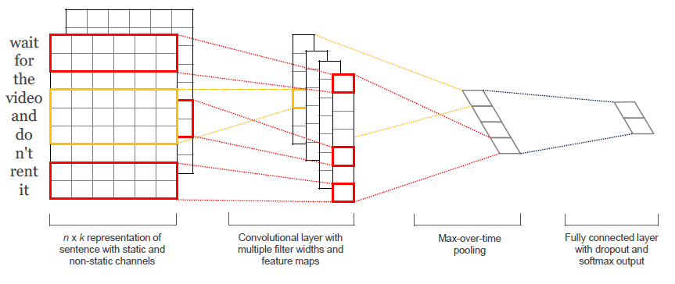
ConvNets for sentence classification
Example: Is a sentence about a movie review express positive sentiment?
Excellent performance on several benchmark datasets!
* Yoon Kim (2014)

Slide 54
Concluding comments
DSMs (Count models) have been around for some time (10-15 years). Predict models give a freshening view.
Predict models seem to be robust to many levels of simplification.
There is mostly It works kind of papers. It would be useful to have Why It works kind of papers.
Good and clean evaluations are very important for saying one method is better than another.

Slide 55
Some open problems that you can easily start working on
Predict model (Log bilinear) uses dot products between embeddings of words and context words. But finally dot product of word embeddings is used for similarity. What is the basis?
Also, how did the linguistic regularities come about? Formulation had nothing about it.
Can you find ways of adding domain knowledge, e.g., from Wordnet?
How do the methods work on small corpuses?
Do detailed experiments on the effect of various context modelings on the quality of the word vectors.
Find a good semi-supervised formulation that mixes the Log bilinear model with a supervised model that uses word vectors.
Composition of word vectors to deal with higher objects such as sentences, paragraphs and documents is a more difficult space, but very open right now. It is hot because of its usefulness in machine translation, question answering, document summarization, non-thematic classification problems such as sentiment analysis, etc.

Slide 56
Appendix

Slide 57
References
M. Baroni et al (2014) – Don’t count, predict.. – ACL [pdf]
Y. Bengio et al (2003) – A neural probabilistic.. – JMLR [pdf]
J.A. Bullinaria and J.P. Levy (2007) – Extracting semantic representations.. 1 – Behavior Research Methods, 39, 510-526 [pdf]
J.A. Bullinaria and J.P. Levy (2012) – Extracting semantic representations.. 2 – Behavior Research Methods, 44, 890-907 [pdf]
S. Clark (2015) – Vector space models.. – Handbook of Contemp. Semantics [pdf]
E. Grefenstette (2014) - New Directions in Vector Space Models of Meaning - ACL Tutorial [pdf]
T.K. Landauer et al (1998) – Learning human-like knowledge.. – NIPS [pdf]
O. Levy and Y. Goldberg (2014a) - word2vec Explained.. - arXiv [pdf]
O. Levy and Y. Goldberg (2014b) - Linguistic Regularities in Sparse.. - CoNLL [pdf]
O. Levy and Y. Goldberg (2014c) - Neural Word Embeddings as Implicit.. - NIPS [pdf]

Slide 58
References..
T. Mikolov, W.T. Yih and G. Zweig (2013) – Linguistic regularities.. – HLT-NAACL [pdf]
T. Mikolov et al (2013a) Distributed representations.. – NIPS [pdf]
T. Mikolov et al (2013b) Efficient estimation of word.. – arXiv – [pdf]
A. Mnih and G. Hinton (2007) - A Scalable Hierarchical.. – NIPS [pdf]
A. Mnih and K. Kavukcuoglu (2013) - Learning word embeddings – NIPS [pdf]
F. Morin and Y. Bengio (2005) – Hierarchical probabilistic neural.. – AISTATS [pdf]
A. Neelakantan et al (2014) - Efficient Non-parametric Estimation of Multiple Embeddings… - EMNLP [pdf]
P.D. Turney and P. Pantel (2010) - From frequency to meaning.. – JAIR [pdf]
Yoon Kim (2014) – Convolutional neural networks for.. – EMNLP [pdf]

Slide 59
Evaluation datasets*
Semantic relatedness: In this task, humans were asked to rate the relatedness of two words, and the system correlation with these scores is measured.
rg: 65 noun pairs by Rubenstein & Goodenough (1965)
ws: Wordsim353, 353 word pairs by Finkelstein et al. (2002)
wss: Subset of Wordsim353 focused on similarity (Agirre et al., 2009)
wsr: Subset of Wordsim353 focused on relatedness (Agirre et al., 2009)
men: 1000 word pairs by Bruni et al. (2014)
Synonym detection: The system needs to find the correct synonym for a word.
toefl: 80 multiple-choice questions with 4 synonym candidates (Landauer & Dumais, 1997).
* Baroni et al (2014)

Slide 60
Concept categorization: Given a set of concepts, the system needs to group them into semantic categories.
ap: 402 concepts in 21 categories (Almuhareb, 2006)
esslli: 44 concepts in 6 categories (Baroni et al., 2008)
battig: 83 concepts in 10 categories (Baroni et al., 2010)
Selectional preferences: Using some examples, the system needs to decide how likely a noun is to be a subject or object for a specific verb.
up: 221 word pairs (Pado, 2007)
mcrae: 100 noun-verb pairs (McRae et al., 1998)
Analogy: Using examples, the system needs to find a suitable word to solve analogy questions, such as: “X is to ‘uncle’ as ‘sister’ is to ‘brother'”
an: ~19,500 analogy questions (Mikolov et al., 2013b)
ansyn: Subset of the analogy questions, focused on syntactic analogies
ansem: Subset of the analogy questions, focused on semantic analogies

